Slide 1


Operating System Design
Chapter 13:
Managing I/O Devices
Serial No 24
Nitish Rawat (M110248CS)
National Institute Of Technology Calicut

Slide 2
Outline
Device Drivers
Levels of Kernel Support
Buffering Strategies of Device Drivers
Registering a Device Driver
Initializing a Device Driver
Monitoring I/O Operations
Block Device Drivers
Initializing a Block Device Driver
Buffer Heads

Slide 3
VFS Handling of Device Files
Device files live in the system directory tree but are intrinsically different from regular files and directories.
It is the VFS's responsibility to hide the differences between device files and regular files from application programs.
VFS changes the default file operations of a device file when it is opened. The device-related function acts on the hardware device to perform the requested operation.

Slide 4
Device Drivers
It is a software layer that makes hardware device respond to programming interface.
The actual implementation of all VFS functions (open, read, lseek, ioctl, and so forth) is delegated to the device driver.
Before using a device driver, two activities must have taken place: registering the device driver and initializing the device driver. Finally, it must also monitor the I/O operation.

Slide 5
Types of Device Drivers
Types of Drivers differ in
  the level of support that they offer to the User Mode applications,
  as well as in their buffering strategies for data collected from the hardware devices.

Slide 6
Levels of Kernel Support
Three possible kinds of support for a hardware device:
No support at all – eg. X Window System
Minimal support
Extended support – eg. Internal hard disk

Slide 7
Buffering Strategies of Device Drivers
Input data is read one character at a time from the device input register and stored in a proper kernel data structure; the data is then copied at leisure into the process address space. Similarly, it is done for output data.
Device driver must be able to cope with data, even when CPU
  Use of the DMA processor (DMAC) to transfer blocks of data.
  Use of circular buffer of two or more elements.

Slide 8
Registering a Device Driver
Registering a device driver means linking it to the corresponding device files.
Accesses to device files whose corresponding drivers have not been previously registered return the error code -ENODEV.
Statically compiled device driver – registration performed during kernel initialization phase.
Conversly – Compiled as a kernel module and can also unregister itself when module is inloaded

Slide 9
Registering a Device Driver
Character device driver
  Described by a chrdevs array of device_struct data structures.
  Each structure includes two fields:
    name points to name of the device
    fops points to a file_operations structure.

Slide 10
Registering a Device Driver
Block device driver
  Described by a blkdevs array of 255 data structures.
  Each structure includes two fields:
    name points to name of the device
    bdops points to a block_device_operations structure.
The register_blkdev() functions insert a new entry into one of the tables eg:
  register_chrdev(6, “lp” , &lp_fops);

Slide 11
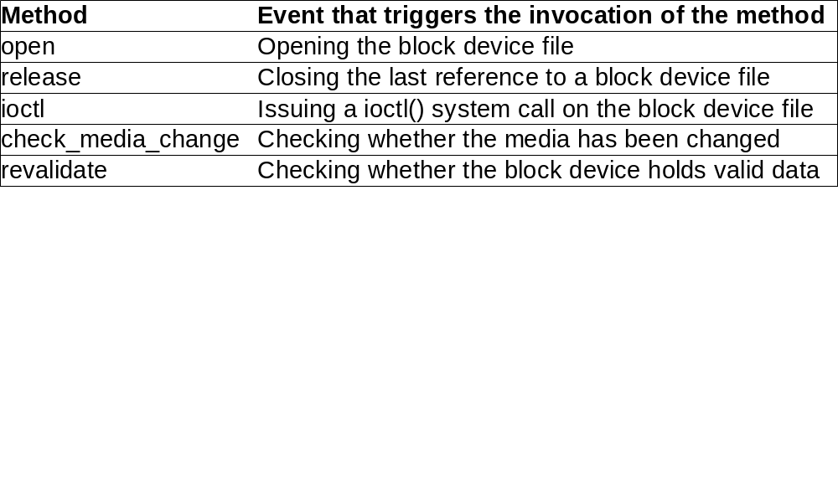
Methods of Block device drivers

Slide 12
Initializing a Device Driver
Initializing a driver means allocating precious resources of the system, which are therefore not available to other drivers.
The assignment of IRQs to devices is usually made dynamically, right before using them, since several devices may share the same IRQ line.
Other resources possible are page frames for DMA transfer buffers and the DMA channel itself.

Slide 13
Device Driver resource schema
A usage counter is increamented in the open method of the device file and decremented in the release method.
The open method checks the value of counter. If it is null, the device driver must allocate the resources and enable interrupts.
The release method also checks the value of counter. If it is null, the method disables interrupts and releases allocated resources.

Slide 14
Monitoring I/O Operations
The device driver that started an I/O operation must rely on a monitoring technique that signals either the termination of the I/O operation or a time-out. The techniques available are called
  Polling mode
  Interrupt mode

Slide 15
Monitoring I/O Operations
In case of a terminated operation, the device driver reads the status register of the I/O interface to determine whether the I/O operation was carried out successfully.
In case of time-out, the maximum time interval allowed to complete the operation elapsed and nothing happened.

Slide 16
Polling mode
The CPU checks (polls) the device's status register repeatedly until its value signals that the I/O operation has been completed.
An example of polling looks like the following:
  for (;;) {
    If (read_status(device) & DEVICE_END_OPERATION) break;
    If (--count == 0) break;
  }

Slide 17
Interrupt mode
It is preferable to implement the driver using the interrupt mode where the device driver doesn't know in advance how much time it has to wait for an answer from the hardware device.
The driver includes two functions:
  The foo_read() that implement the read method of the file object.
  The foo_interrupt() function that handles the interrupt

Slide 18
Interrupt mode
The main operations of the foo_read() function are the following:
  Acquires the foo_dev->sem semaphore, thus ensuring the no other process is accessing the device.
  Clears the intr flag.
  Issues the read command to the I/O device.
  Executes wait_event_interruptible to suspend the process until the intr flag becomes 1.

Slide 19
Interrupt mode
When the scheduler decides to reexecute the process, the second part of foo_read() is executed and does the following:
  Copies the character ready in the foo_dev->data variable into the user address space.
  Terminates after releasing the foo_dev->sem semaphore.

Slide 20
Block Device Drivers
Kernel support for block device handlers includes the following features:
  A uniform interface through the VFS
  Efficient read-ahead of disk data
  Disk caching for the data

Slide 21
Block Device Drivers
When a block device file is being opened, the kernel must determine whether the device file is already open.
We use the term “block device driver”, we mean the kernel layer that handles I/O data transfers from/to a hardware device specified by both a major number and a minor number.

Slide 22
Block Device Drivers
A real complication, however, is that block device files that have the same major and minor numbers but different pathnames are regarded by the VFS as different files, but they really refer to the same block device driver.
To keep track, the kernel uses a hash table indexed by the major and minor numbers.
If a block device driver associated with the given numbers is not found, the kernel inserts a new element into hash table.

Slide 23
block_device data structure
Hash table includes 64 lists of descriptors. The fields are:
Type | Field | Description
Struct list_head | bd_hash | Pointers for the hash table list
atomic_t | bd_count | Usage counter for the block device descriptor
struct inode * | bd_inode | Pointer to the main inode object of the block device driver
dev_t | bd_dev | Major and minor numbers of the block device
int | bd_openers | Counter of how many times the block device driver has been opened
struct block_device_operations * | bd_op | Pointer to the block device driver operation table
struct semaphore | bd_sem | Semaphore protecting the block device driver
struct list_head | bd_inodes | List of inodes of opened block device files for this driver

Slide 24
Initializing a Block Device Driver
Kernel customizes the methods of the file object when a block device file is opened. The default file operation methods for block device files are:
Method | Function for block device file
open | blkdev_open()
release | blkdev_close()
llseek | block_llseek()
read | generic_file_read()
write | generic_file_write()
mmap | generic_file_mmap
fsync | block_fsync()
ioctl | blkdev_ioctl()

Slide 25
Initializing a Block Device Driver
The function checks whether the block device driver is already in use:
  bd_acquire(inode);
  do_open(inode->i_bdev, filp);
The device driver initialization function must determine the size of the physical block device. The length, represented in 1024-byte units, is stored in the blk_size global array.

Slide 26
Initializing a Block Device Driver
The bd_acquire() function essentially executes the following operations:
  Checks whether block device file is already open.
  Looks up block device driver in the hash table.
  Stores the address of the block device driver descriptor in inode->i_bdev.
  Adds inode to the list of inodes of descriptor.

Slide 27
Initializing a Block Device Driver
Next, blkdev_open() invokes do_open(), which executes the following main steps:
  Checks and initializes bd_op field of the block device driver descriptor corresponding to the major number of the block device file.
  Invokes the open method of the block device driver descriptor
  Increments the bd_openers counter of the block device driver drescriptor
  Sets the i_size and i_blkbits fields of the block device inode object (bd_inode).

Slide 28
Sectors, Blocks, and Buffers
Data transfer operation for a block device acts on a group of adjacent bytes called a sector.
In most disks, the size of a sector is 512 bytes.
The kernel stores the sector size of each hardware block device in a table named hardsect_size.
Block device drivers transfer a large number of adjacent bytes called a block in a single operation

Slide 29
Sectors, Blocks, and Buffers (contd...)
In Linux, the block size must be a power of 2 and cannot be larger than a page frame.
The same block device driver may operate with several block-sizes, since it has to handle a set of device files sharing the same major number. For instance, a block device driver could handle a hard disk with two partitions containing an Ext2 filesystem and a swap area.

Slide 30
Sectors, Blocks, and Buffers (contd...)
Each block requires its own buffer, which is a RAM memory area used by the kernel to store the block's content.
When a driver reads/write a block from/to disk. It fills/updates the corresponding buffer with values.
The size of a buffer always matches the size of the corresponding block.

Slide 31
Buffer Heads
The buffer head is a descriptor of type buffer_head associated with each buffer.
It contains information needed by the kernel to know how to handle the buffer.

Slide 32
The Fields of a Buffer Head
Type | Field | Description
unsigned long | b_blocknr | Logical block number
unsigned long | b_size | Block size
kdev_t | b_dev | Virtual device identifier
kdev_t | b_rdev | Real device identifier
unsigned long | b_rsector | Number of initial sector in real device
unsigned long | b_state | Buffer status flags
unsigned int | b_count | Block usage counter
char * | b_data | Pointer to buffer
unsigned long | b_flushtime | Flushing time for buffer
struct wait_queue * | b_wait | Buffer wait queue
struct buffer_head * | b_next | Next item in collision hash list
struct buffer_head ** | b_pprev | Previous item in collision hash list
struct buffer_head * | b_this_page | Per-page buffer list
struct buffer_head * | b_next_free | Next item in list
struct buffer_head * | b_prev_free | Previous item in list
unsigned int | b_list | LRU list including the buffer
struct buffer_head * | b_reqnext | Request's buffer list
void (*)( ) | b_end_io | I/O completion method
void (*) | b_dev_id | Specialized device driver data

Slide 33
Flags of b_state field (1 of 2)
BH_Uptodate – Set if the buffer contains valid data.
BH_Dirty – Set if the buffer is dirty.
BH_Lock – Set if the buffer is locked.
BH_Req – Set if the corresponding block is requested and has valid data.
BH_Mapped – Set if the buffer is mapped to disk.

Slide 34
Flags of b_state field (2 of 2)
BH_New – Set if the corresponding file block has never been accessed.
BH_Async – Set if the buffer is being processed by end_buffer_io_async()
BH_Wait_IO – Used to delay flushing the buffer to disk when reclaiming memory.
BH_launder – Set when the buffer is being flushed to disk when reclaiming memory.
BH_JBD – Set if the buffer is used by a journaling filesystem.

Slide 35
Buffer heads
The b_dev field indentifies the virtual device containing the block stored in the buffer while the b_rdev field identifies the real space.
This distinction has been introduced to model Redundant Array of Independent Disks (RAID) storage.
The b_blocknr field represents the logical block number.

Slide 36
References:
Understanding the Linux Kernel, Second Edition
by Daniel P.Bovet and Marco Cesati

Slide 37
Questions?

Slide 38
Thank You

